Slide 1
How might your students' understanding of addition progress/develop/evolve? What will you do as the teacher to help move your students toward proficiency?
Fatima Ahmed

Slide 2
According to a lecture, students move through four phases. Under each phase, the strategy being employed is listed.
The key ideas speaks to the principles that the students need to master in order to apply the strategy in question

Slide 3
How children will progress

Slide 4
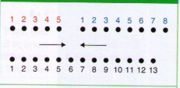
Direct modeling and counting
You can expect children to add items by counting three times. For instance, if they are asked to add 5 to 8, they may fount 5 and 8 individually than they will put the two together to count 1 to 13.

Slide 5
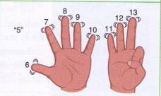
Direct modeling and counting
Counting on/counting back strategy requires children to start counting up from 5.

Slide 6
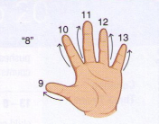
Counting more efficiently and tracking
This strategy is different from counting on/counting back because it requires children to count up from the bigger number, which is 8 in this case. The children still get to 13 as they count 5 up from 8.

Slide 7
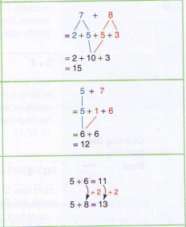
Working with numbers
Decomposing
Using the five-anchor and 10-anchor
Making 10 strategy
Using a known fact (e.g. 6+6=12)
Using up/down over 10
Partial sums
Splitting
Taking jumps of 10 forward and backward

Slide 8
Proficiency
At this stage, children are able to rely on automatic retrieval of facts. For instance, 5+8 may automatically mean 13 without any use of strategy.
At this level, they may also use standard or alternative algorithms.
“Children become proficient when they learn the facts by focusing on the relationships among the numbers.” (p. 22)

Slide 9
Key ideas being employed

Slide 10
Cardinality
Through this principle, the students are able to conclude that 5 does not refer only to the item they are tagging, but rather refers to the entire group of objects from the item they tagged at 1 to the item they tagged at 5.

Slide 11
Part whole relationship
Through this principle, students are ablet o conclude that numbers are made up of two numbers. For instance, 10 can be made up of 9 & 1, 2 & 8, 3 &7, 4 & 6 or 5 & 5. Thus, they recognize that 9 & 1 are two separate numbers, for instance.

Slide 12
Hierarchical inclusion
This principle is an extension of part-part-whole relationships. Through this, students are able to conclude that if they have five objects than that means they also have at least 4 objects since 5 is made up of 4.

Slide 13
Commutative property
This property states that the order of addition does not matter. This means that if they tried adding 5 to 8, or if they tried adding 8 to 5, the answer would be the same.

Slide 14
Associative property
Through the associative property, students are bale to conclude that if they were asked to add 5 & 7, they could break down the 5 in 3 & 2, and add it to 7. Or they could break down the 7 into 2 & 5, and add it to 5. Thus additions can be regrouped without changing the sum.

Slide 15
Equivalence
Through the principle of equivalence, students are able to understand that if they add 1 to (5+6) than they also have to add 1 to 11, since 5+6=11. Or, if they take away 1 from 4 in the case of 4+6, they have to give that 1 to 6 thus making 7. Through such operations, students discover that amounts can not just disappear and any change has to compensated or adjusted to the remaining numbers.

Slide 16
Models to support addition

Slide 17
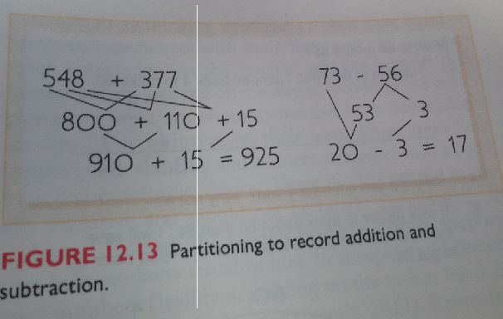
Partitioning
Through the practicing of partitioning, students can separately add 100s, 10s, and 1s. For instance, in the case of 548 + 377, they can add 500 to 300, and get 800. They can add 40 to 70, and get 110, and they can add 8 to 7 and get 15. After they can add these three numbers to get the final answer of 925.

Slide 18
Number line
Students can find great ease in number lines, for instance if asked to add 45 to 32, drawing 45, than adding 30 in the form of 3 jumps of 10, can help to get to 75. The remainder of two unties is added to reach a final total of 77.

Slide 19
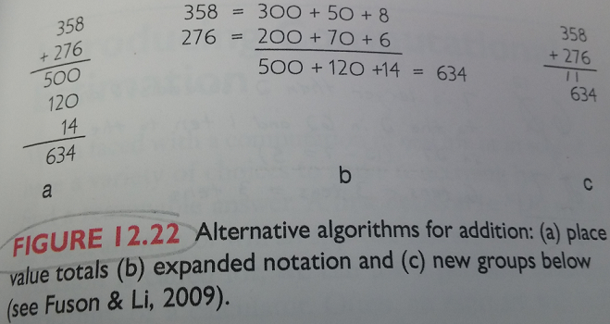
Alternative algorithms
The slide shows the three alternative algorithms for additions, called the ‘place value totals’, ‘expanded notations’ and ‘new groups’ respectively. They all rely on the partitioning ability explained a few slides earlier.

Slide 20
What I will do as the teacher to help move your students toward proficiency

Slide 21
Three categories of current ideas
As an educator, I intend to follow the advice presented in the TIMSS study article. The author of the article writes, “On the basis of responses from teachers in the United States, the TIMSS identified three categories of current ideas about mathematics. These ideas involve (a) hands-on real-world mathematics, (b) cooperative learning and (c) a focus on thinking”. (Geist, 2000, 184). Thus, as an educator, I will attempt to activate these three ideas on a daily basis during my mathematics class.

Slide 22
Introduce mathematical models
“Children can construct all of the thinking of an alternative algorithm, we help them organize” (lecture on Sept 27, 2018). Thus, as an educator, I will give students the opportunity to experiment as they try to construct thinking of an alternative algorithm. However, it was stated in our texts that students need to be introduced to models as they are unable to come up with models on their own, and thus, while allowing them to experiment with alternative algorithms, I would also introduce mathematical models, such as number lines, so that they have tools through which to understand and analyze mathematical concepts presented to them.

Slide 23
Encourage fluency with tens
In my personal experience, I benefitted the most if I was able to become an expert at using one strategy or model. Following that, I was able to use that as an anchor point as I tried to solve any other mathematical problem. This approach also syncs with my philosophy that educators should focus more on building the strengths of the student, rather than spending excess amounts of time trying to address their weaknesses. This was also advised during our readings, where it was written that “Learning one type of computational strategy will inform understanding of another.” (Walle, 2017, p. 196) Thus, as an example, I would try to build fluency with tens within my students so that once they are able to become experts on that topic, they can use that as a tool or anchor point through which to efficiently solve other addition problems.

Slide 24
Use of manipulatives and schematic diagrams
As I underwent primary school in a foreign country, I was only introduced to the ten-frame while reading the textbook for this course. After seeing how the professor demonstrated the usage of this ten frame in an elementary class, I was impressed at its potency and its ability to help students build their mental math ability. Thus, as an educator, I will continue to research the manipulatives and schematic diagrams that are available for students, and I will continue to introduce these to the students.

Slide 25
Positive self concept
One of our readings state that "Relational understanding has an affective effect as well as a cognitive effect. When ideas are well understood and make sense, the learner tends to develop a positive self concept about his or her ability to learn and understand mathematics." (Van de Walle, 2007, p. 27). Thus, as an educator, my greatest emphasis will be on building a positive self concept when it comes to the topic of mathematics and I will continue to research strategies and theories through which I can achieve this goal with my students.

Slide 26
Lingering Questions

Slide 27
“Some regression may be possible when children are faced with larger numbers”
There is a concept in conflict studies that practitioners sometimes need to wait for the conflict to reach its peak, in order to intervene and perform resolution. When I read that some regression may be possible when children are faced with larger numbers, I was reminded of this conflict resolution theory. If we, as an educator, see that a child is regressing, I wonder how long I have to wait or how I will know when to intervene. How much regression is considered acceptable level, and when should an educator start to worry if the regression continues.

Slide 28
“Learning one type of computational strategy will inform understanding of another.” (Walle, 2017, p. 196)
While I myself agree that learning one type of computational strategy will inform understanding of another, I wonder as an educator on what is the best computational strategy to introduce to each student and at what time. I worry that by introducing an inappropriate strategy, one that is too demanding or not demanding enough, that the child may face an obstacle in developing a positive self-concept.

Slide 29
Bibliography

Slide 30
Barker, L. (2009). Ten is the magic number. Teaching Children Mathematics, 15(6), 337-343. Retrieved October 4, 2018, from https://www.nctm.org/Publications/teaching-children-mathematics/2009/Vol15/Issue6/Ten-Is-the-Magic-Number!/.
Bofferding, L., Kemmerle, M., & Murata, A. (2012). Making 10 My Way. Teaching Children Mathematics, 19(3), 164-173. doi:10.5951/teacchilmath.19.3.0164
Cooper, K. (2018, September 20). Week 3: Addition and Subtraction. Lecture presented in Lakehead University, Orillia.
Geist, E. (2000). Lessons from the TIMSS Videotape Study. Teaching Children Mathematics, 7(3), 180-185. Retrieved October 4, 2018, from https://www.nctm.org/Publications/teaching-children-mathematics/2000/Vol7/Issue3/Lessons-from-the-TIMSS-Videotape-Study/.
Lawson, A. (n.d.). What to Look For Paperback(1st ed.). Pearson Canada.
Van de Walle, J. A., Karp, K. S., Bay-Williams, J. M., & McGarvey, L. M. (2017). Elementary and middle school mathematics: Teaching developmentally(5th ed.). NY, NY: Pearson.

