Slide 1
On migrations and mental health
EDUC 4034
Photo-text essay
Fatima Ahmed

Slide 2
A prose from a sufi singer, on the topic of finding one’s identity
Na main momin vich maseetaan Not a believer inside the mosque, am I
Na main vich kufar diyan reetaan Nor a pagan disciple of false rites
Na main paakaan vich paleetaan Not the pure amongst the impure
Na main moosa na firown Neither Moses, nor the Pharoh
Bulleya Ki jaana main Kaun Bulleya! to me, I am not known
Na main arabi na lahori Not an Arab, nor Lahori
Na main hindi shehar nagauri Neither Hindi, nor Nagauri
Na hindu na turak peshawri Hindu, Turk, nor Peshawari
Na main rehnda vich nadaun Nor do I live in Nadaun
Bulleya Ki jaana main Kaun Bulleya! to me, I am not known
Na main bheth mazhab da paaya Secrets of religion, I have not known
Ne main aadam havva jaaya From Adam and Eve, I am not born
Na main apna naam dharaaya I am not the name I assume
Na vich baitthan na vich bhaun Not in stillness, nor on the move
Bulleya Ki jaana main Kaun Bulleya! to me, I am not known

Slide 3
Pre-partition map of subcontinental india Inquiry: Roles, Responsibilities, and Identity A2.3 Analyse and construct simple maps as part of their investigations into places that are significant to them or to their family
The egg that created me was formed inside of my mother’s fetus while she was inside my grandmother’s womb. Thus, my migration story begins in Lucknow.

Slide 4
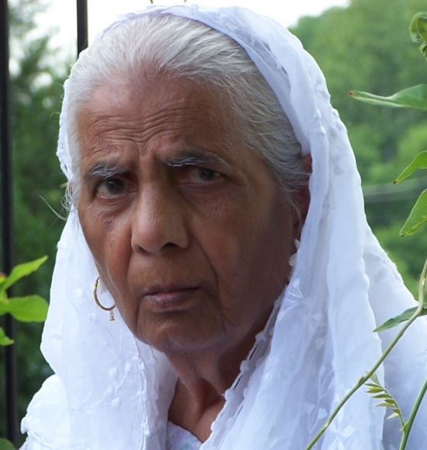
Ghulam janat and Safiyyah SIDDIQUI Application: Why Roles and Responsibilities Change A1.4 describe the impact that people can have on each other in some different situations and some of the ways in which interactions between people can affect a person’s sense of self
My paternal grandfather was estranged while my maternal grandfather passed away before my birth. I only knew my grandmothers while growing up.

Slide 5
On travel Inquiry: Roles, Responsibilities, and Identity A2.2 gather and organize information on significant events, people, and/or places in their lives that contribute or have contributed to the development of their roles, relationships, responsibilities, and identity/sense of self using primary and/or secondary sources that they have located themselves or that have been provided to them
My father served in the Pakistani military for over 20 years, because of which we moved within Pakistan every few years.

Slide 6
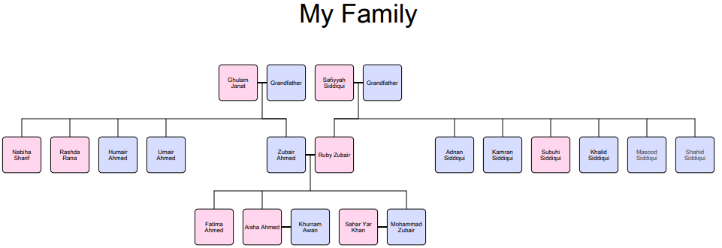
On family Application: Why Roles and Responsibilities Change A1.3 Compare some of the significant events in their own lives and/or the lives of their family members with those in the lives of their peers
We led a comfortable life in Pakistan, however, my extended family primarily resided in North America and when we were given the chance, we chose to join them overseas.

Slide 7
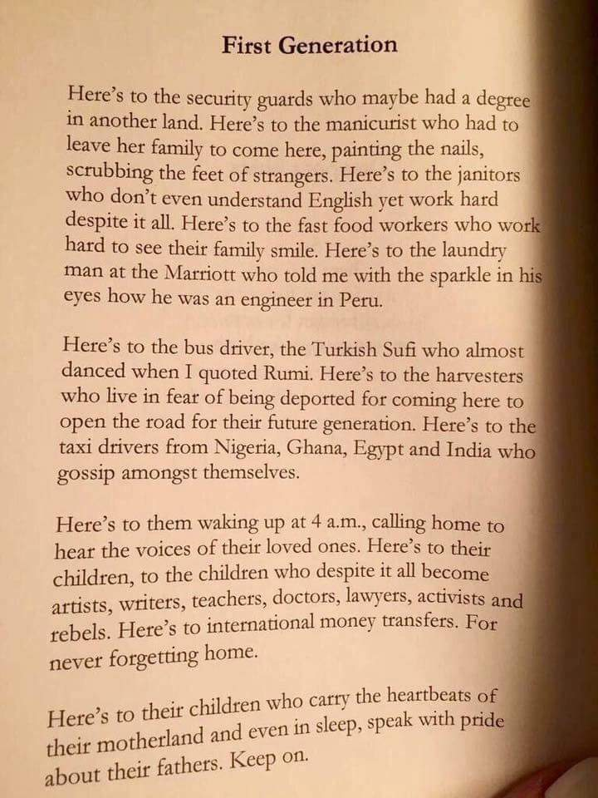
On career transitions Application: Why Roles and Responsibilities Change A1.1 describe how and why a person’s roles, relationships, and responsibilities may change in different places or situations and at different times
But who is a Lieutenant Colonel once he has retired; depression ensued for years as my father tried to find a new vocation after immigrating to Canada.

Slide 8
On personal travel Inquiry: Roles, Responsibilities, and Identity A2.2 gather and organize information on significant events, people, and/or places in their lives that contribute or have contributed to the development of their roles, relationships, responsibilities, and identity/sense of self
A map of the various places I have lived, worked and/or studied.

Slide 9
On mental health Application: Why Roles and Responsibilities Change A1.2 describe how some significant events in their lives led to changes in their roles, relationships, and/or responsibilities
Due to a recent diagnosis of Bipolar disorder and PTSD, I am no longer able to travel and work internationally the way I was able to, before the diagnosis.

Slide 10
On heritage Inquiry: Roles, Responsibilities, and Identity A2.5 evaluate evidence and draw conclusions about some aspects of the interrelationship between events, people, and/or places in their lives and their own roles, relationships, responsibilities, and identity/sense of self
One of the causal factors for bipolar disorder is genetic predisposition – which means either my grandmother’s dementia or my father’s depressive symptoms could have been reasons why I developed bipolar disorder. Migration and mental illness is therefore what I have inherited.

Slide 11
A prose from the indian sub-continent on the topic of wanderlust
How's this selfishness of yours, Kaisee teri khudgarzee
that you don't take the sun, nor take the shade.. Na dhoop chune na chhaanv
How's this selfishness of yours, Kaisee teri khudgarzee
that your feet don't stay anywhere.. Kisi thaur tike na paanv
You've tried being your own god, Ban liyaa apnaa paighambar
and crossed all seven seas, Tar liyaa tu saat samandar
Still, there is a draught within your heart, Phir bhee sookhaa mann ke andar
Why is it so.. Kyoon reh gaya

Slide 12
References
Bhattacharya, A. (n.d.). Kabira Naina Lyrics Translation | Neha Kakkar, Irfan. Retrieved October 5, 2018, from https://lyricsmeanwhat.blogspot.com/2017/06/t-series-mixtape-kabira-naina-lyrics.html
Bulleya Ki Jana Main Kaun. (2009, November 25). Retrieved October 5, 2018, from https://sufipoetry.wordpress.com/2009/11/01/bulleya-ki-jana-main-kaun/

